Slide 1
EECS 498 System Design of a Search Engine
Winter 2026
Lecture 13: The index and constraint solver
Nicole Hamilton
https://web.eecs.umich.edu/~nham/
nham@umich.edu

Slide 2
agenda
details
forms redux
the index
index stream readers
the constraint solver

Slide 3
agenda
details
forms redux
the index
index stream readers
the constraint solver

Slide 4
details
Still not written the midterm. Yes, I may ask you about anything in lectures today and next Tuesday.
The http://web.eecs.umich.edu/ redirect bug has been fixed.
I’ve posted my forms example to Canvas as ExampleForms.zip in the Files > Examples folder on Canvas. You will need to supply your own LinuxTinyServer.cpp and Plugin.h to compile and make them work.

Slide 5
agenda
details
forms redux
the index
index stream readers
the constraint solver

Slide 6
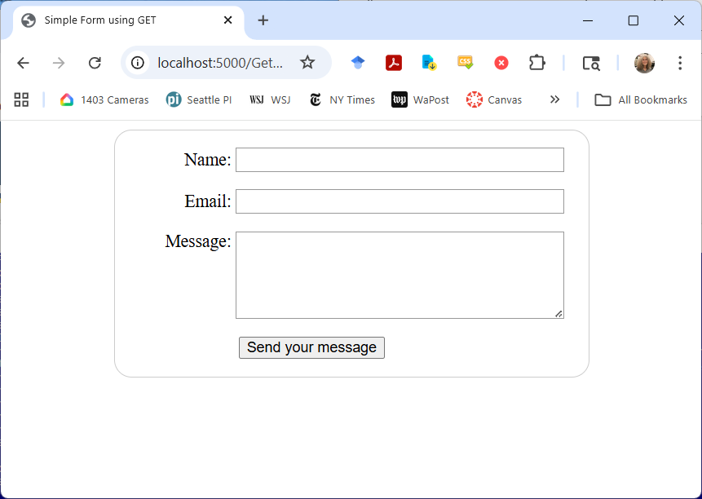
<!DOCTYPE html>
<html>
<head>
<title>Simple Form using GET/title>
<link href="SimpleForm.css" rel="stylesheet">
</head>
<body>
<form action="/GetForm.htm" method="get">
<div>
<label for="name">Name:</label>
<input type="text" id="name" name="user_name" />
</div>
<div>
<label for="mail">Email:</label>
<input type="email" id="mail" name="user_email" />
</div>
<div>
<label for="msg">Message:</label>
<textarea id="msg" name="user_message"></textarea>
</div>
<div class="button">
<button type="submit">Send your message</button>
</div>
</form>
</body>
</html>

Slide 7
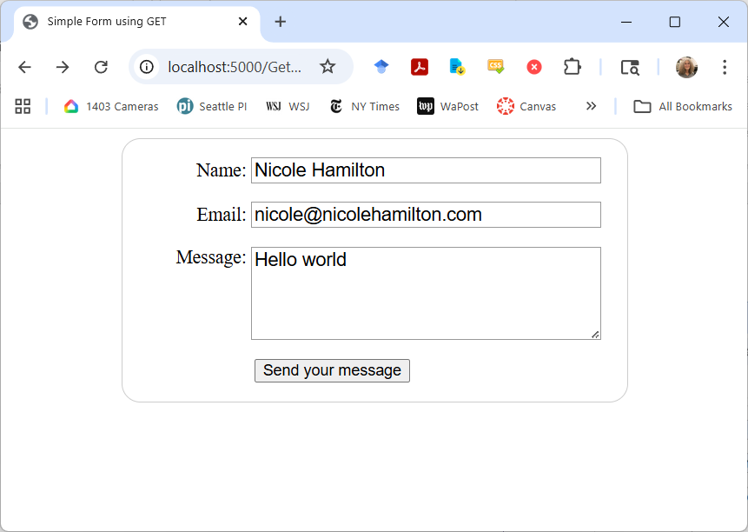
Typing this and pressing Send sends a GET message to the server with the form information passed as ? query string.
http://localhost:5000/GetForm.htm?user_name=Nicole+Hamilton&user_email=nicole%40nicolehamilton.com&user_message=Hello+world

Slide 8
LinuxTinyServer sees this.
GET /GetForm.htm?user_name=Nicole+Hamilton&user_email=nicole%40nicoleh
amilton.com&user_message=Hello+world HTTP/1.1
Host: localhost:5000
Connection: keep-alive
:
User-Agent: Mozilla/5.0 (Windows NT 10.0; Win64; x64) AppleWebKit/537.36 (KHTML, like Gecko) Chrome/139.0.0.0 Safari/537.36
Accept: text/html,application/xhtml+xml,application/xml;q=0.9,image/avif,image/webp,image/apng,*/*;q=0.8,application/signed-exchange;v=b3;q=0.7
:
Referer: http://localhost:5000/GetForm.htm
Accept-Encoding: gzip, deflate, br, zstd
Accept-Language: en-US,en;q=0.9

Slide 9
Since that’s not a filename and I haven’t defined a plugin, it fails as a 404.
Path does not exist.
HTTP/1.1 404 Not Found
Content-Length: 0
Connection: close
But obviously, we could intercept that and make it do something useful.

Slide 10
parsing the GET message
The server sees the
GET /GetForm.htm?user_name=Nicole+Hamilton&user_email=nicole%40nicolehamilton.com&user_message=Hello+world
To parse the name, email and message values:
The query starts after the question mark.
Individual assignments are split apart at the ampersands.
+’s are replaced with spaces.
The entire string is URL unencoded, e.g., %40 becomes @.

Slide 11
// Plugin interface for the GetForm.
#include <string.h>
#include <vector>
#include <iostream>
#include "Plugin.h"
using namespace std;
string UnencodeUrlEncoding( string &path );

Slide 12
// Split up a query string into separate assignments at
// the ampersands, replace +'s with spaces, and unencode
// URL encoding, and return them as a vector of strings.
vector< string > split( const char *query )
{
const char *p = query;
char c;
vector< string > parms;
string parm;
while ( *p && *p != ' ' )
{
parm = "";
for ( ; ( c = *p ) && c != '&' && c != ' '; parm += c, p++ )
if ( c == '+' )
c = ' ';
parm = UnencodeUrlEncoding( parm );
parms.push_back( parm );
if ( c == '&' )
p++;
}
return parms;
}

Slide 13
// Search the vector of parameters, looking for one
// that matches. If found, return the value.
string GetValue( vector< string > parms, const char *name )
{
for ( auto parm : parms )
{
const char *p = parm.c_str( ), *n = name;
while ( *n && *n == *p )
n++, p++;
if ( *n == 0 )
// Matched! What's left is the value.
return p;
}
return "";
}

Slide 14
// Plugin interface for the GetForm.
class GetPlugin: PluginObject
{
public:
// MagicPath returns true if this is a path the plugin
// intercepts.
bool MagicPath( const string path )
{
const char *q = path.c_str( );
char c;
while ( ( c = *q ) && c != '?' )
q++;
return c == '?';
}

Slide 15
string ProcessRequest( string request )
{
const char *p, *query;
string name, email, message;
for ( p = request.c_str( ); *p && *p != '?'; p++ )
;
query = *p ? p + 1 : p;
vector< string > parms = split( query );
name = GetValue( parms, "user_name=" );
email = GetValue( parms, "user_email=" );
message = GetValue( parms, "user_message=" );
string response =
"<!DOCTYPE html>\n“
:
" Name: " + name + "<br/>\n" +
" Email: " + email + "<br/>\n" +
" Message: " + message + "\n"
:
" </body>\n"
"</html>";
return
"HTTP/1.1 200 OK\r\n"
"Content-Length: " + to_string( response.size( ) ) + "\r\n"
"Connection: close\r\n"
"Content-Type: text/html\r\n"
"\r\n" +
response;
}

Slide 16
GetPlugin( )
{
Plugin = this;
}
~GetPlugin( )
{
}
};
// Instantiate the class.
GetPlugin getplugin;

Slide 17
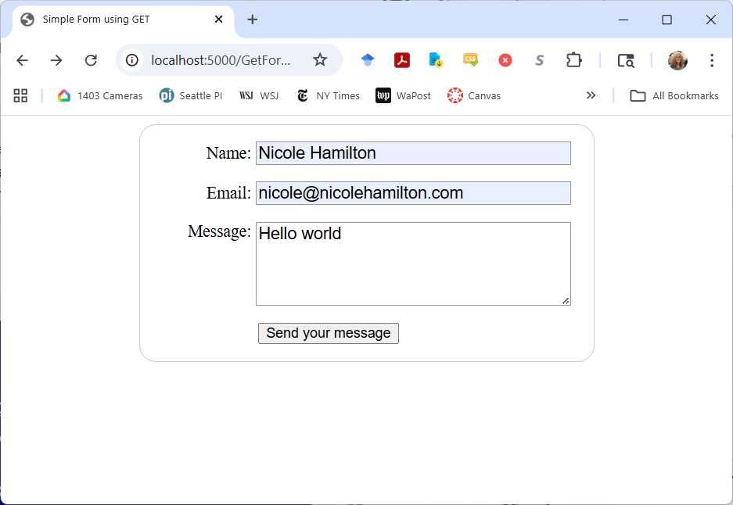

Slide 18
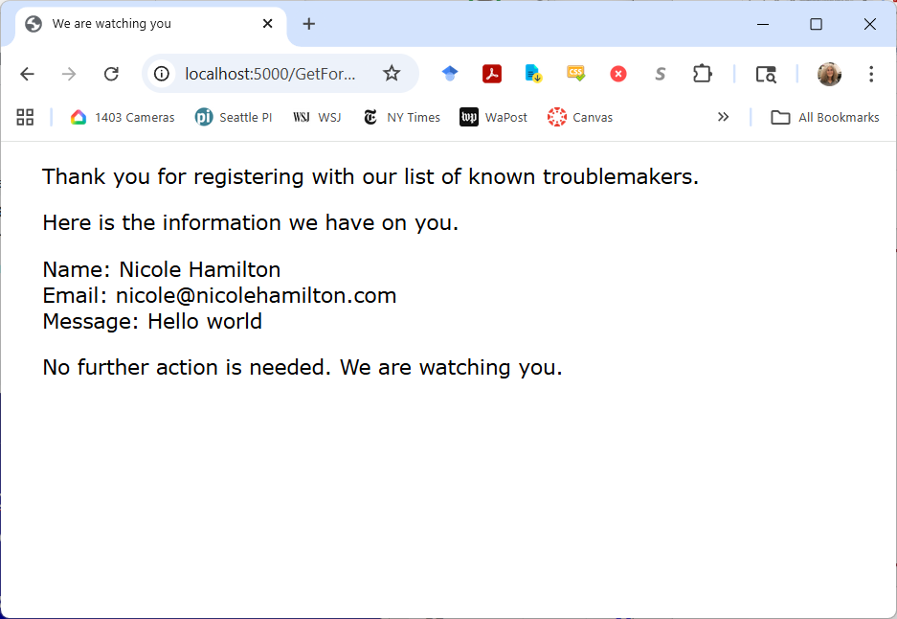

Slide 19
POST example is similar
Major difference is values are passed as content.
Need to define a special path to intercept.

Slide 20
agenda
details
forms redux
the index
index stream readers
the constraint solver

Slide 21
the index
Basic problem:
Create an inverted word index of all the documents that have been crawled, allowing you to report all the documents and individual locations (postings) where any given word was found.

Slide 22
the index
Due to the size, it will all have to be on disk but memory-mapped into your address space.
You’ll depend on the virtual memory manager to keep heavily-referenced sections, e.g., the dictionary at the front, in memory. But the bottleneck will be disk access.

Slide 23
the index
Search time will grow linearly with the size of the index because every matching page will have to found and scored unless you short-circuit, e.g., by arbitrarily cutting it off after the first 20,000 matches to avoid getting trapped by searches for “a” or “the”.
Most of size will be in the posting lists, so if the posting lists can be compressed, your engine will be faster.

Slide 24
A search engine index is typically a set of files
Master index
Index chunk
Index chunk
Index chunk
Index chunk
…
The master index might itself be a set of files capturing the overall state of the search engine.
Configuration settings
Frontier
List of index chunks
Each index chunk
List of URLS
Inverted word index

Slide 25
A search engine index is typically a set of files
Master index
Index chunk
Index chunk
Index chunk
Index chunk
…
Typically, as pages are crawled and parsed, they’re added to the next index chunk under construction. Once a chunk is full, you start filling a new chunk. Don’t make them too small nor too big, but there’s a huge in-between. Common choices might be a few hundred megabytes.
When a query comes in, each chunk must be searched, either sequentially or in parallel with separate threads.

Slide 26
The inverted word index within a chunk.
Dictionary
Posting list
Posting list
Posting list
…
Posting list
A posting list
Common Header
Type-specific data
Index
Post
Post
Post
…
Sentinel
An individual post
Delta from previous post loc
Type-specific data

Slide 27
The dictionary
Dictionary
Posting list
Posting list
Posting list
…
Posting list
Dictionary contains:
Number of tokens in the index.
Number of unique tokens in the index.
Number of documents in the index.
Hash table to translate from token to offset to the posting list.
Since collisions are possible, it’s possible you might have to skip over the collisions, likely pasted one after another.
Tokens can be decorated to distinguish words in the title vs. the body or URL, etc., and to create special tokens, e.g., end-of-document.

Slide 28
The dictionary
Dictionary
Posting list
Posting list
Posting list
…
Posting list
Words are usually case-folded in the dictionary.
Outer punctuation, e.g., a comma at the end of a word, is usually discarded. Special characters, accents, and numbers is sometimes discarded.
May do stemming, lemmatization and/or stop word elimination but it’s unclear how helpful this is. Tends to increase the number of matches but recall isn’t as important for a search engine as precision.

Slide 29
stemming and lemmatization
The common goal is to reduce a word a simpler form.
Stemming reduces a token to pseudostems (not necessarily real words) using a heuristic process that chops off or replaces prefixes or suffixes.
Lemmatization uses a vocabulary to find the dictionary form of the word, known as a lemma.
This is a special case of normalization, like lower-casing all the letters.

Slide 30
Porter stemmer
M.R. Porter, “An algorithm for suffix stripping”, 1980. https://tartarus.org/martin/PorterStemmer/def.txt
Probably the most popular.
Uses 5 phases of word reductions.
Each phase has rules for replacing the longest suffix.
Downloadable as a library but off-limits for the project.

Slide 31
Rules can have conditions
*S - the stem ends with S (and similarly for the other letters).
v - the stem contains a vowel.
*d - the stem ends with a double consonant (e.g. -TT, -SS).
*o - the stem ends cvc, where the second c is not W, X or Y (e.g. -WIL, -HOP).
Step 1a
SSES -> SS caresses -> caress
IES -> I ponies -> poni
ties -> ti
SS -> SS caress -> caress
S -> cats -> cat
Step 1b
(m>0) EED -> EE feed -> feed
agreed -> agree
(*v*) ED -> plastered -> plaster
bled -> bled
(*v*) ING -> motoring -> motor
sing -> sing

Slide 32
The dictionary
Dictionary
Posting list
Posting list
Posting list
…
Posting list
At Microsoft, we discarded all punctuation but then needed to special case certain terms, e.g., C++. We used dictionary-based word-breaking on URLs and with documents and queries in Japanese, which happened to be an important market for Microsoft.

Slide 33
The dictionary
Dictionary
Posting list
Posting list
Posting list
…
Posting list
May have multiple kinds of things in the dictionary, e.g., document boundaries vs. words.
Each type of post may have attributes, for example:
word Bold, heading, large font. (But beware it may not be all that helpful in ranking.)
document URL, number of word or unique words in the URL, title, body, anchor.
May also distinguish variations on word, e.g., only in the URL vs. only in the title, by decorating the word when entering it into the dictionary.

Slide 34
Decorating
Dictionary
Posting list
Posting list
Posting list
…
Posting list
Add characters that get stripped out during HTML parsing to indicate special characteristics or types of posts, e.g.,
amazon amazon in the body text
#amazon amazon only in the URL
@amazon amazon only in the title
$amazon amazon only in the anchor text
% End-of-document token.
Might also be used for stemming:
swim* swim, swims, swimming, etc.

Slide 35
Decorating
Dictionary
Posting list
Posting list
Posting list
…
Posting list
Use decorating when you’d like to use it for searching, to shrink the size of a post or because you’d like to separate the scoring for hits in the title vs. the body for example.
For example, you might decide to search for hits in titles only before deciding whether you need search pages that don’t have hits in the title.
Use attributes when the ranker will want the information about each post and it could be different every time.

Slide 36
A posting list
Common Header
Type-specific data
Index
Post
Post
Post
…
Sentinel
Common header might contain:
Number of occurrences of this token in the index.
Number of documents in which this token occurs.
Type of token: end-of-document, word in anchor, URL, title or body.
Size of the list for skipping over collisions.
For an end-of-document list, type-specific data might include:
Lengths of the document, URL and title.
Amount of anchor text, number of unique words.
Any additional static rank information, e.g., date, number of links pointing to the page, etc.

Slide 37
A posting list
Common Header
Type-specific data
Index
Post
Post
Post
…
Sentinel
An individual post
Delta from previous post loc
Type-specific data
It’s important to keep the posts as small as possible on average.
This is commonly done by giving the location as a delta from the previous post and then encoding that delta in a variable number of bytes, e.g., as UTF-8.

Slide 38
Delta from previous post
The offset will typically be encoded with a variable length scheme like UTF-8.
If only a few bits of type-specific information are needed, they can be encoded into the low bits of the UTF-8 character.
Delta from previous post
Type-specific data
00 Normal
01 Italic
10 Bold
11 Heading
Bits … 4 3 2 1 0

Slide 39
Anchor text tends to duplicate, with many links to the same page with the same anchor text.
For a word in anchor text, it can be useful to sort the phrases, retaining only the unique phrases but with counts on the words.
Because the counts can be so large, it can be helpful to shrink the number of bits required with the log function.
Delta from previous post
log( Count )
Bits … 4 3 2 1 0

Slide 40
anchor text
Anchor text is hard.
It’s not in the page being indexed, it’s in all the other pages.
As you crawl, you’ll continue to collect more anchor text for pages already indexed.
Probably requires a separate index.

Slide 41
A posting list
Common Header
Type-specific data
Index
Post
Post
Post
…
Sentinel
An individual post
Delta from previous post loc
Type-specific data
You have a choice whether to number locations relative to:
Start of the document or
Start of the index
If you go with start of document, individual word locations will be ( docid, offset ), causing a large delta every time you cross a document boundary.
If you go with start of index, a word location is simply an offset, and the deltas between locations will likely to be smaller binary numbers.

Slide 42
A posting list
Common Header
Type-specific data
Index
Post
Post
Post
…
Sentinel
An individual post
Delta from previous post loc
Type-specific data
Most posting lists will be of actual words found on a page.
But there will be at least one other important posting list of document ends, marking the boundaries between documents pasted one after another in the index.

Slide 43
A posting list
Common Header
Type-specific data
Index
Post
Post
Post
…
Sentinel
An individual post
Delta from previous post loc
Type-specific data
All the posts on a given list likely have the same type-specific data but the amount of data and number of bytes might vary and be whatever you like.
For a word, the type-specific information might be title or bold.
For a document end, it might be the URL (or an index into a table of URLs), the document title, document statistics, whatever you want.

Slide 44
agenda
details
the index
index stream readers
the constraint solver

Slide 45
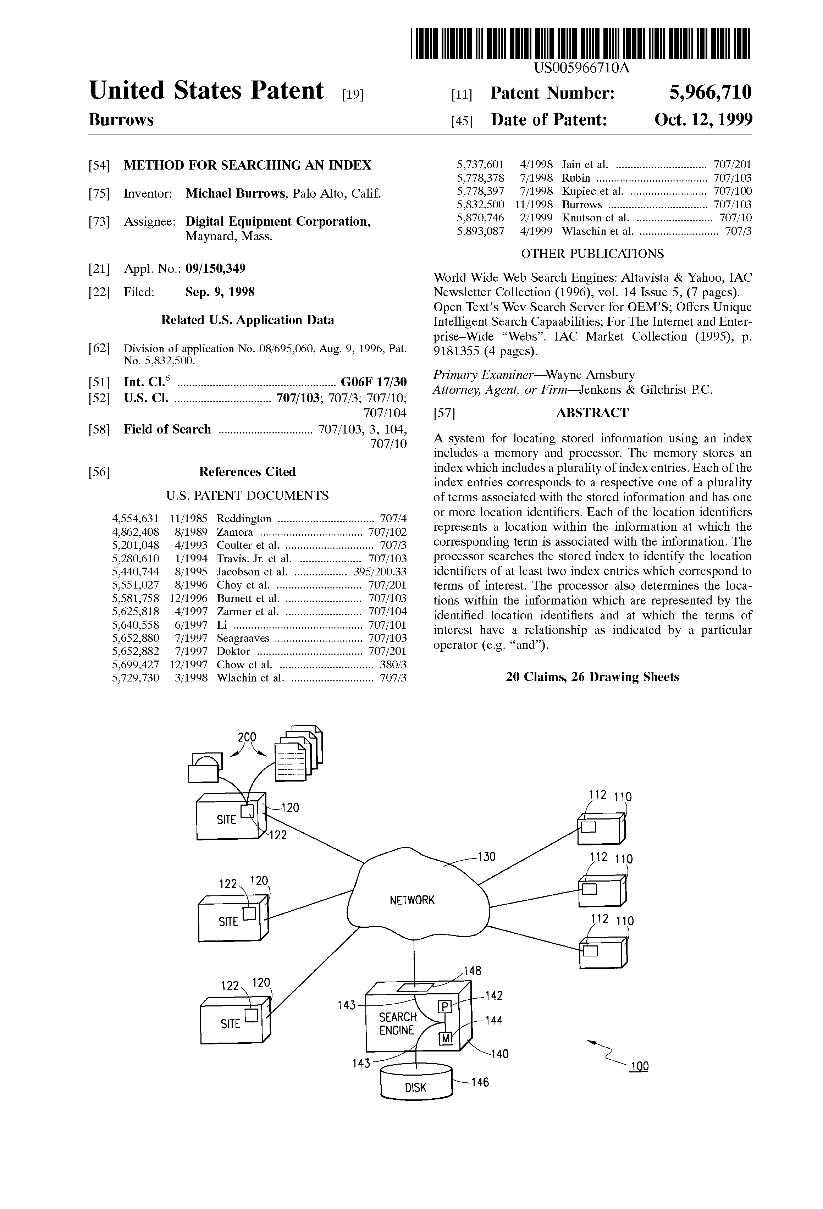
index stream readers
Idea is to step through posting lists looking for intersections.
Invented by Mike Burrows at AltaVista.
Briefly worked for Microsoft at the very beginning of what became Bing and contributed this to the initial design.
(Left because his girlfriend was in the SF Bay area, shortly before I joined the team.)

Slide 46
two uses
Find matching documents. Skip over documents that don’t match as fast as possible.
Rank those documents. Scan through all the occurrences of the search words and phrases on a matching page as fast as possible.

Slide 47
index stream readers
Index stream readers (ISRs)
OpenISR( t ) Create an ISR for given term t, set to the first occurrence, if there is one.
next( ) Move the ISR to the next post in the list.
seek( location ) Move the ISR to the first post after the specified location.
prev( ) Move the ISR to the immediately preceding post. Not needed, usually omitted.

Slide 48
seeking
The posting lists can be huge.
Important to reduce space.
Usual strategy is to encode each new location as a delta from the previous.
Further encode with varying numbers of bits depending on the delta.
Some number of bits may encode attributes.
Don’t want to have to add all the previous deltas (there could be millions of them!) to know the actual location number.
Synchronization points allow seeking to a location just prior to desired location, then scanning forward, so you only have to add up a smaller number of deltas.

Slide 49
A posting list
Common Header
Type-specific data
Index
Post
Post
Post
…
Sentinel
Posting list index
Post
A function and a data structure that allows skipping ahead to a synchronization point, a known offset into the posting list and the location of that post as close as possible but not after the seek location.
Post
Seek location
Post
…
Sentinel

Slide 50
A posting list
Common Header
Type-specific data
Index
Post
Post
Post
…
Sentinel
Posting list index
Post
Post
Seek location
( offset, location ) = Seek( location );
Gets close to where you want, then scan from there, adding up deltas.
Post
…
Sentinel

Slide 51
To seek to a specific word location without having to start from the beginning, adding up all the deltas until you get there, you use the seek table to get you close.
It gives you a synchronization point where you can jump in and start reading, looking for the location you want.
From there, you read forward, accumulating location deltas until we either hit a post at the seek address or the first post after that (or end of list).
Posting list index
( offset, location ) = Seek( location );
Gets close to where you want, then scan from there, adding up deltas.

Slide 52
A posting list
Common Header
Type-specific data
Index
Post
Post
Post
…
Sentinel
Posting list index example
Post
Synchronization points
High bits of seek location | Seek offset in the postings | Actual location of that post.
0000 0000 | 0 | 32
0000 0001 | 531 | 20142
0000 0010 | 2012 | 912348
: | : | :
Post
Seek location
Post
…
Sentinel

Slide 53
Imagine we used 16-bit location numbers and consider a seek to hex 0x01AD.
We might use the high byte, 0x01, as the index into a seek table of 256 entries.
SeekTable[ 0x01 ] should contain two members:
An offset to the first posting that occurs at a word location >= 0x0100 or null if there isn't one.
The actual word location of that first post, perhaps 20142.
Posting list index
Synchronization points
High bits of seek location | Seek offset in the postings | Actual location of that post.
0000 0000 | 0 | 32
0000 0001 | 531 | 20142
0000 0010 | 2012 | 912348
: | : | :

Slide 54
agenda
details
the index
index stream readers
the constraint solver

Slide 55
agenda
details
the index
index stream readers
the constraint solver

Slide 56
constraint solver
Given an inverted word index and a constraint, e.g., a list of words that must appear together or as a phrase in a document, find the list of matching documents.

Slide 57
The query language is typically recursive.
"apollo moon landing" | ( apple banana )
OR
The parse tree
Phrase
AND
"apollo"
"moon"
"landing"
"apple"
"banana"

Slide 58
Basic idea is to create ISR structures that match the query constraints. Each ISR can find the next occurrence of whatever it’s looking for.
"apollo moon landing" | ( apple banana )
OR ISR
The ISR structure
Phrase ISR
AND ISR
apollo ISR
moon ISR
landing ISR
apple ISR
banana ISR

Slide 59
"apollo moon landing" | ( apple banana )
The trees are the same.
OR
The parse tree
Phrase
AND
"apollo"
"moon"
"landing"
"apple"
"banana"
OR ISR
The ISR structure
Phrase ISR
AND ISR
apollo ISR
moon ISR
landing ISR
apple ISR
banana ISR

Slide 60
AND ISR
The AND of apple and banana might actually take 12 ISRs if the terms are decorated, e.g.,
@ = anchor, # = title, / = url.
apple ISR
banana ISR
AND ISR
OR ISR
EndDoc ISR
OR ISR
@apple ISR
apple ISR
@banana ISR
banana ISR
#apple ISR
/apple ISR
#banana ISR
/banana ISR

Slide 61
"apollo moon landing" phrase actually requires 4 ISRs for each stream (anchor, title, URL and body) + an OR ISR = 17 ISRs.
Phrase ISR
apollo ISR
moon ISR
landing ISR
OR ISR
Phrase ISR
Phrase ISR
@apollo ISR
@moon ISR
@landing ISR
apollo ISR
moon ISR
landing ISR
Phrase ISR
Phrase ISR
#apollo ISR
#moon ISR
#landing ISR
/apollo ISR
/moon ISR
/landing ISR
Assume decorations: @ = anchor, # = title, / = url

Slide 62
Coming back to the question, is this correct?
"apollo moon landing" | ( apple banana )
1 ISR
OR ISR
17 ISRs
Phrase ISR
12 ISRs
AND ISR
apollo ISR
moon ISR
landing ISR
apple ISR
banana ISR
If the terms are decorated, it could take 30 ISRs.

Slide 63
Matches in order of importance:
Anchor text.
URL.
Title.
Body.
Exception is Japan were URL matches are less useful due to mismatch between Kanji or Katakana queries and transliterated URLs.
Indexing URLs requires dictionary word-breaking. An alternative is to do string matching against the URL during ranking of pages that already match.

Slide 64
Does it matter how many ISRs you use?
How much effect will this have on query search time?
What dominates search time?

Slide 65
Index Stream Reader (ISR)
Finds the next occurrence of the desired token or combination of child ISRs.
ISRWord Find occurrences of individual words.
ISREndDoc Find occurrences of document ends.
ISROr Find occurrences of any child ISR.
ISRAnd Find occurrences of all child ISRs within a single document.
ISRPhrase Find occurrences of all child ISRs as a phrase.
ISRContainer Find occurrences of contained ISRs in a single document not containing any excluded ISRs.

Slide 66
typedef size_t Location; // Location 0 is the null location.
typedef size_t FileOffset;
typedef union Attributes
{
WordAttributes Word;
DocumentAttributes Document;
};
class Post
{
public:
virtual Location GetStartLocation( );
virtual Location GetEndLocation( );
virtual Attributes GetAttributes( );
};

Slide 67
class PostingList
{
private:
struct PostingListIndex
{
FileOffset Offset;
Location PostLocation;
};
PostingListIndex *index;
virtual char *GetPostingList( );
public:
virtual Post *Seek( Location );
};

Slide 68
class ISR
{
public:
virtual Post *Next( );
virtual Post *NextDocument( );
virtual Post *Seek( Location target );
virtual Location GetStartLocation( );
virtual Location GetEndLocation( );
};
class ISRWord : public ISR
{
public:
unsigned GetDocumentCount( );
unsigned GetNumberOfOccurrences( );
virtual Post *GetCurrentPost( );
};
class ISREndDoc : public ISRWord
{
public:
unsigned GetDocumentLength( );
unsigned GetTitleLength( );
unsigned GetUrlLength( );
};

Slide 69
class Dictionary
{
public:
ISR *OpenIsr( char *token );
size_t GetNumberOfWords( );
size_t GetNumberOfUniqueWords( );
size_t GetNumberOfDocuments( );
};
class Index
{
public:
size_t WordsInIndex,
DocumentsInIndex
LocationsInIndex,
MaximumLocation;
ISRWord *OpenISRWord( char *token );
ISRWord *OpenISREndDoc( );
};

Slide 70
Consider these posting lists
quick 10 27 105 513 518 520
brown 28 50 62 70 514 790
fox 87 106 515 550 1200
#DocEnd 112 570 1006 1704
To read and merge these lists, we need to move from one entry to the next.
We'll do that with an ISR (index stream reader).
The ISR for each token has to be able to report its current location and attributes, and it needs Next( ) and Seek( ) functions.

Slide 71
OR'ing streams
quick 10 27 105 513 518 520
brown 28 50 62 70 514 790
fox 87 106 515 550 1200
#DocEnd 112 570 1006 1704
quick | fox 10 27 87 105 106 513 515 518 520 550 1200
An OR ISR simply merges the streams.
No need to pay attention to document boundaries. Each post is in whichever posting list and whatever document it happens to be.

Slide 72
class ISROr : public ISR
{
public:
ISR **Terms;
unsigned NumberOfTerms;
Location GetStartLocation( )
{
return nearestStartLocation;
}
Location GetEndLocation( )
{
return nearestEndLocation;
}
Post *Seek( Location target )
{
// Seek all the ISRs to the first occurrence beginning at
// the target location. Return null if there is no match.
// The document is the document containing the nearest term.
}
Post *Next( )
{
// Do a next on the nearest term, then return
// the new nearest match.
}

Slide 73
Post *NextDocument( )
{
// Seek all the ISRs to the first occurrence just past
// the end of this document.
return Seek( DocumentEnd->GetEndLocation( ) + 1 );
}
private:
unsigned nearestTerm;
// nearStartLocation and nearestEndLocation are
// the start and end of the nearestTerm.
Location nearestStartLocation, nearestEndLocation;
};

Slide 74
AND'ing streams
quick 10 27 105 513 518 520
brown 28 50 62 70 514 790
fox 87 106 515 550 1200
#DocEnd 112 570 1006 1704
quick fox ?
AND'ing of terms should find occurrences of all the terms within a single document.
Should it return every possible combination, every combination only changing the nearest ISR or the first match in each matching document?

Slide 75
AND'ing streams
Easier to consider if we show the document boundaries.
quick 10 27 105 513 518 520
brown 28 50 62 70 514 790
fox 87 106 515 550 1200
#DocEnd 112 570 1006 1704
quick fox ?
To determine what document a post falls within, we advance a #DocEnd ISR to the next document end, where we can retrieve information about the document, including its length.
This tells us the start and end points of the document and whether all the word ISRs point within the same document.

Slide 76
AND'ing streams
quick 10 27 105 513 518 520
brown 28 50 62 70 514 790
fox 87 106 515 550 1200
#DocEnd 112 570 1006 1704
quick fox How many possible combinations?
Can you reach all of them in a single pass, all ISRs only moving forward?
AND'ing of terms should find occurrences of all the terms within a single document.
Should it return every possible combination, every combination only changing the nearest ISR or the first match in each matching document?

Slide 77
AND'ing streams
quick 10 27 105 513 518 520
brown 28 50 62 70 514 790
fox 87 106 515 550 1200
#DocEnd 112 570 1006 1704
quick fox How many possible combinations? 6
Can you reach all of them in a single pass, all ISRs only moving forward? No.
Should it return every possible combination, every combination only changing the nearest ISR or the first match in each matching document?

Slide 78
AND'ing streams
quick 10 27 105 513 518 520
brown 28 50 62 70 514 790
fox 87 106 515 550 1200
#DocEnd 112 570 1006 1704
quick fox How many possible combinations? 6
Can you reach all of them in a single pass, all ISRs only moving forward? No.
Should it return every possible combination, every combination only changing the nearest ISR or the first match in each matching document?
The point of the constraint solver is to find matching pages. Once any match on the page has been found, it's the ranker's job to figure out what to do next

Slide 79
AND'ing streams
quick 10 27 105 513 518 520
brown 28 50 62 70 514 790
fox 87 106 515 550 1200
#DocEnd 112 570 1006 1704
quick fox How many possible combinations? 6
Can you reach all of them in a single pass, all ISRs only moving forward? No.
You probably want both:
Next( ) Advance the nearest ISR and look for the first match.
NextDocument( ) Seeks all the ISRs past the end of the document then looks for the first match.

Slide 80
AND'ing streams
quick 10 27 105 513 518 520
brown 28 50 62 70 514 790
fox 87 106 515 550 1200
#DocEnd 112 570 1006 1704
quick fox NextDocument( ) matches
Next( ) Advance the nearest ISR and look for the first match.
returns ( 10 87 ) ( 27 87 ) ( 105 87 ) ( 105 106 ) ( 513 515 ) ( 518 515 ) ( 518 550 ) ( 520 550 )
NextDocument( ) Seeks all the ISRs past the end of the document then looks for the first match.
returns ( 10 87 ) ( 513 515 )

Slide 81
AND'ing streams
quick 10 27 105 513 518 520
brown 28 50 62 70 514 790
fox 87 106 515 550 1200
#DocEnd 112 570 1006 1704
quick fox NextDocument( ) matches
To look for a new match, your objective is to skip forward through the index as fast as possible.
If a match is to be made including any of the present set of ISR positions, it must include whatever post is furthest down the index.
So there's no point in considering posts on the other lists that occur before the beginning of the document containing that furthest post.

Slide 82
AND'ing streams
quick 10 27 105 513 518 520
brown 28 50 62 70 514 790
fox 87 106 515 550 1200
#DocEnd 112 570 1006 1704
quick fox NextDocument( ) matches
To look for a match:
Advance the #EndDoc ISR to just past the furthest ISR to get the length of the document.
Advance the other ISRs to their first matches starting at the beginning of the document.
If any ISR is past the end of document, you pick the new furthest and continue searching.

Slide 83
class ISRAnd : public ISR
{
public:
ISR **Terms;
unsigned NumberOfTerms;
Post *Seek( Location target )
{
// 1. Seek all the ISRs to the first occurrence beginning at
// the target location.
// 2. Move the document end ISR to just past the furthest
// word, then calculate the document begin location.
// 3. Seek all the other terms to past the document begin.
// 4. If any term is past the document end, return to
// step 2.
// 5. If any ISR reaches the end, there is no match.
}
Post *Next( )
{
return Seek( nearestStartLocation + 1 );
}
private:
unsigned nearestTerm, farthestTerm;
Location nearestStartLocation, nearestEndLocation;
};

Slide 84
class ISRAnd : public ISR
{
public:
ISR **Terms;
unsigned NumberOfTerms;
Post *Seek( Location target )
{
// 1. Seek all the ISRs to the first occurrence beginning at
// the target location.
// 2. Move the document end ISR to just past the furthest
// word, then calculate the document begin location.
// 3. Seek all the other terms to past the document begin.
// 4. If any term is past the document end, return to
// step 2.
// 5. If any ISR reaches the end, there is no match.
}
Post *Next( )
{
return Seek( nearestStartLocation + 1 );
}
private:
unsigned nearestTerm, farthestTerm;
Location nearestStartLocation, nearestEndLocation;
};

Slide 85
Phrase match
Terms must be in consecutive locations.
quick 10 27 105 513 518 520
brown 28 50 62 70 514 790
fox 87 106 515 550 1200
#DocEnd 112 570 1006 1704
"quick brown fox" ( 513 514 515 )
Length of the match must equal to sum of the lengths of the terms.
If a match is to be made including any of the present set of ISR positions, it must include whichever post is furthest down the index.

Slide 86
Phrase match
Terms must be in consecutive locations.
quick 10 27 105 513 518 520
brown 28 50 62 70 514 790
fox 87 106 515 550 1200
#DocEnd 112 570 1006 1704
"quick brown fox" ( 513 514 515 )
Can phrase matches be overlapping?
Do you need to pay attention to document boundaries?
If it’s not a match, do all the ISRs have to move?

Slide 87
Phrase match
Terms must be in consecutive locations.
quick 10 27 105 513 518 520
brown 28 50 62 70 514 790
fox 87 106 515 550 1200
#DocEnd 112 570 1006 1704
"quick brown fox" ( 513 514 515 )
Can phrase matches be overlapping? Yes, if beginning and ending terms match.
Do you need to pay attention to document boundaries? No, not if you skip a location number between documents. All phrase matches will always be within a single document.
If it’s not a match, do all the ISRs have to move? No, you iterate, trying to move the nearest to correct position relative to the furthest.

Slide 88
Phrase match
quick 10 27 105 513 518 520
brown 28 50 62 70 514 790
fox 87 106 515 550 1200
#DocEnd 112 570 1006 1704
"quick brown fox" ( 513 514 515 )
So, what are the functions you might want? Probably want both Next( ) and NextDocument( ).

Slide 89
Phrase match
quick 10 27 105 513 518 520
brown 28 50 62 70 514 790
fox 87 106 515 550 1200
#DocEnd 112 570 1006 1704
"quick brown fox" ( 513 514 515 )
So, what are the functions you might want? Probably want both Next( ) and NextDocument( ).

Slide 90
Phrase match
quick 10 27 105 513 518 520
brown 28 50 62 70 514 790
fox 87 106 515 550 1200
#DocEnd 112 570 1006 1704
"quick brown fox" ( 513 514 515 )
To look for a match:
Pick the furthest ISR.
Advance the other ISRs to their first matches starting at exactly where they should appear to be a matching phrase.
If any ISR is past the desired location, pick the new furthest and continue searching.

Slide 91
class ISRPhrase : public ISR
{
public:
ISR **Terms;
unsigned NumberOfTerms;
Post *Seek( Location target )
{
// 1. Seek all ISRs to the first occurrence beginning at
// the target location.
// 2. Pick the furthest term and attempt to seek all
// the other terms to the first location beginning
// where they should appear relative to the furthest
// term.
// 3. If any term is past the desired location, return
// to step 2.
// 4. If any ISR reaches the end, there is no match.
}
Post *Next( )
{
// Finds overlapping phrase matches.
return Seek( nearestStartLocation + 1 );
}
};

Slide 92
NOTs
Terms that cannot appear in a matching document.
quick 10 27 105 513 518 520
brown 28 50 62 70 514 790
fox 87 106 515 550 1200
#DocEnd 112 570 1006 1704
brown -fox 790
-fox Not allowed
A NOT matches anywhere the term doesn't appear, which is likely pretty nearly everywhere.
So we don't allow searches for nots alone and we don't check for exclusions until we've found an otherwise matching page.

Slide 93
Container ISRs
ISRs that must match and those that must not within a document.
quick 10 27 105 513 518 520
brown 28 50 62 70 514 790
fox 87 106 515 550 1200
#DocEnd 112 570 1006 1704
brown -fox 790
-fox Not allowed
(AND'ing is a special case of a container with no exclusion ISRs.)

Slide 94
class ISRContainer : public ISR
{
public:
ISR **Contained,
*Excluded;
ISREndDoc *EndDoc;
unsigned CountContained,
CountExcluded;
Location Next( );
Post *Seek( Location target )
{
// 1. Seek all the included ISRs to the first occurrence beginning at
// the target location.
// 2. Move the document end ISR to just past the furthest
// contained ISR, then calculate the document begin location.
// 3. Seek all the other contained terms to past the document begin.
// 4. If any contained erm is past the document end, return to
// step 2.
// 5. If any ISR reaches the end, there is no match.
// 6. Seek all the excluded ISRs to the first occurrence beginning at
// the document begin location.
// 7. If any excluded ISR falls within the document, reset the
// target to one past the end of the document and return to
// step 1.
};

Slide 95
Post *Next( )
{
Seek( Contained[ nearestContained ]->GetStartlocation( ) + 1 );
}
private:
unsigned nearestTerm, farthestTerm;
Location nearestStartLocation, nearestEndLocation;
};

